Slide 1
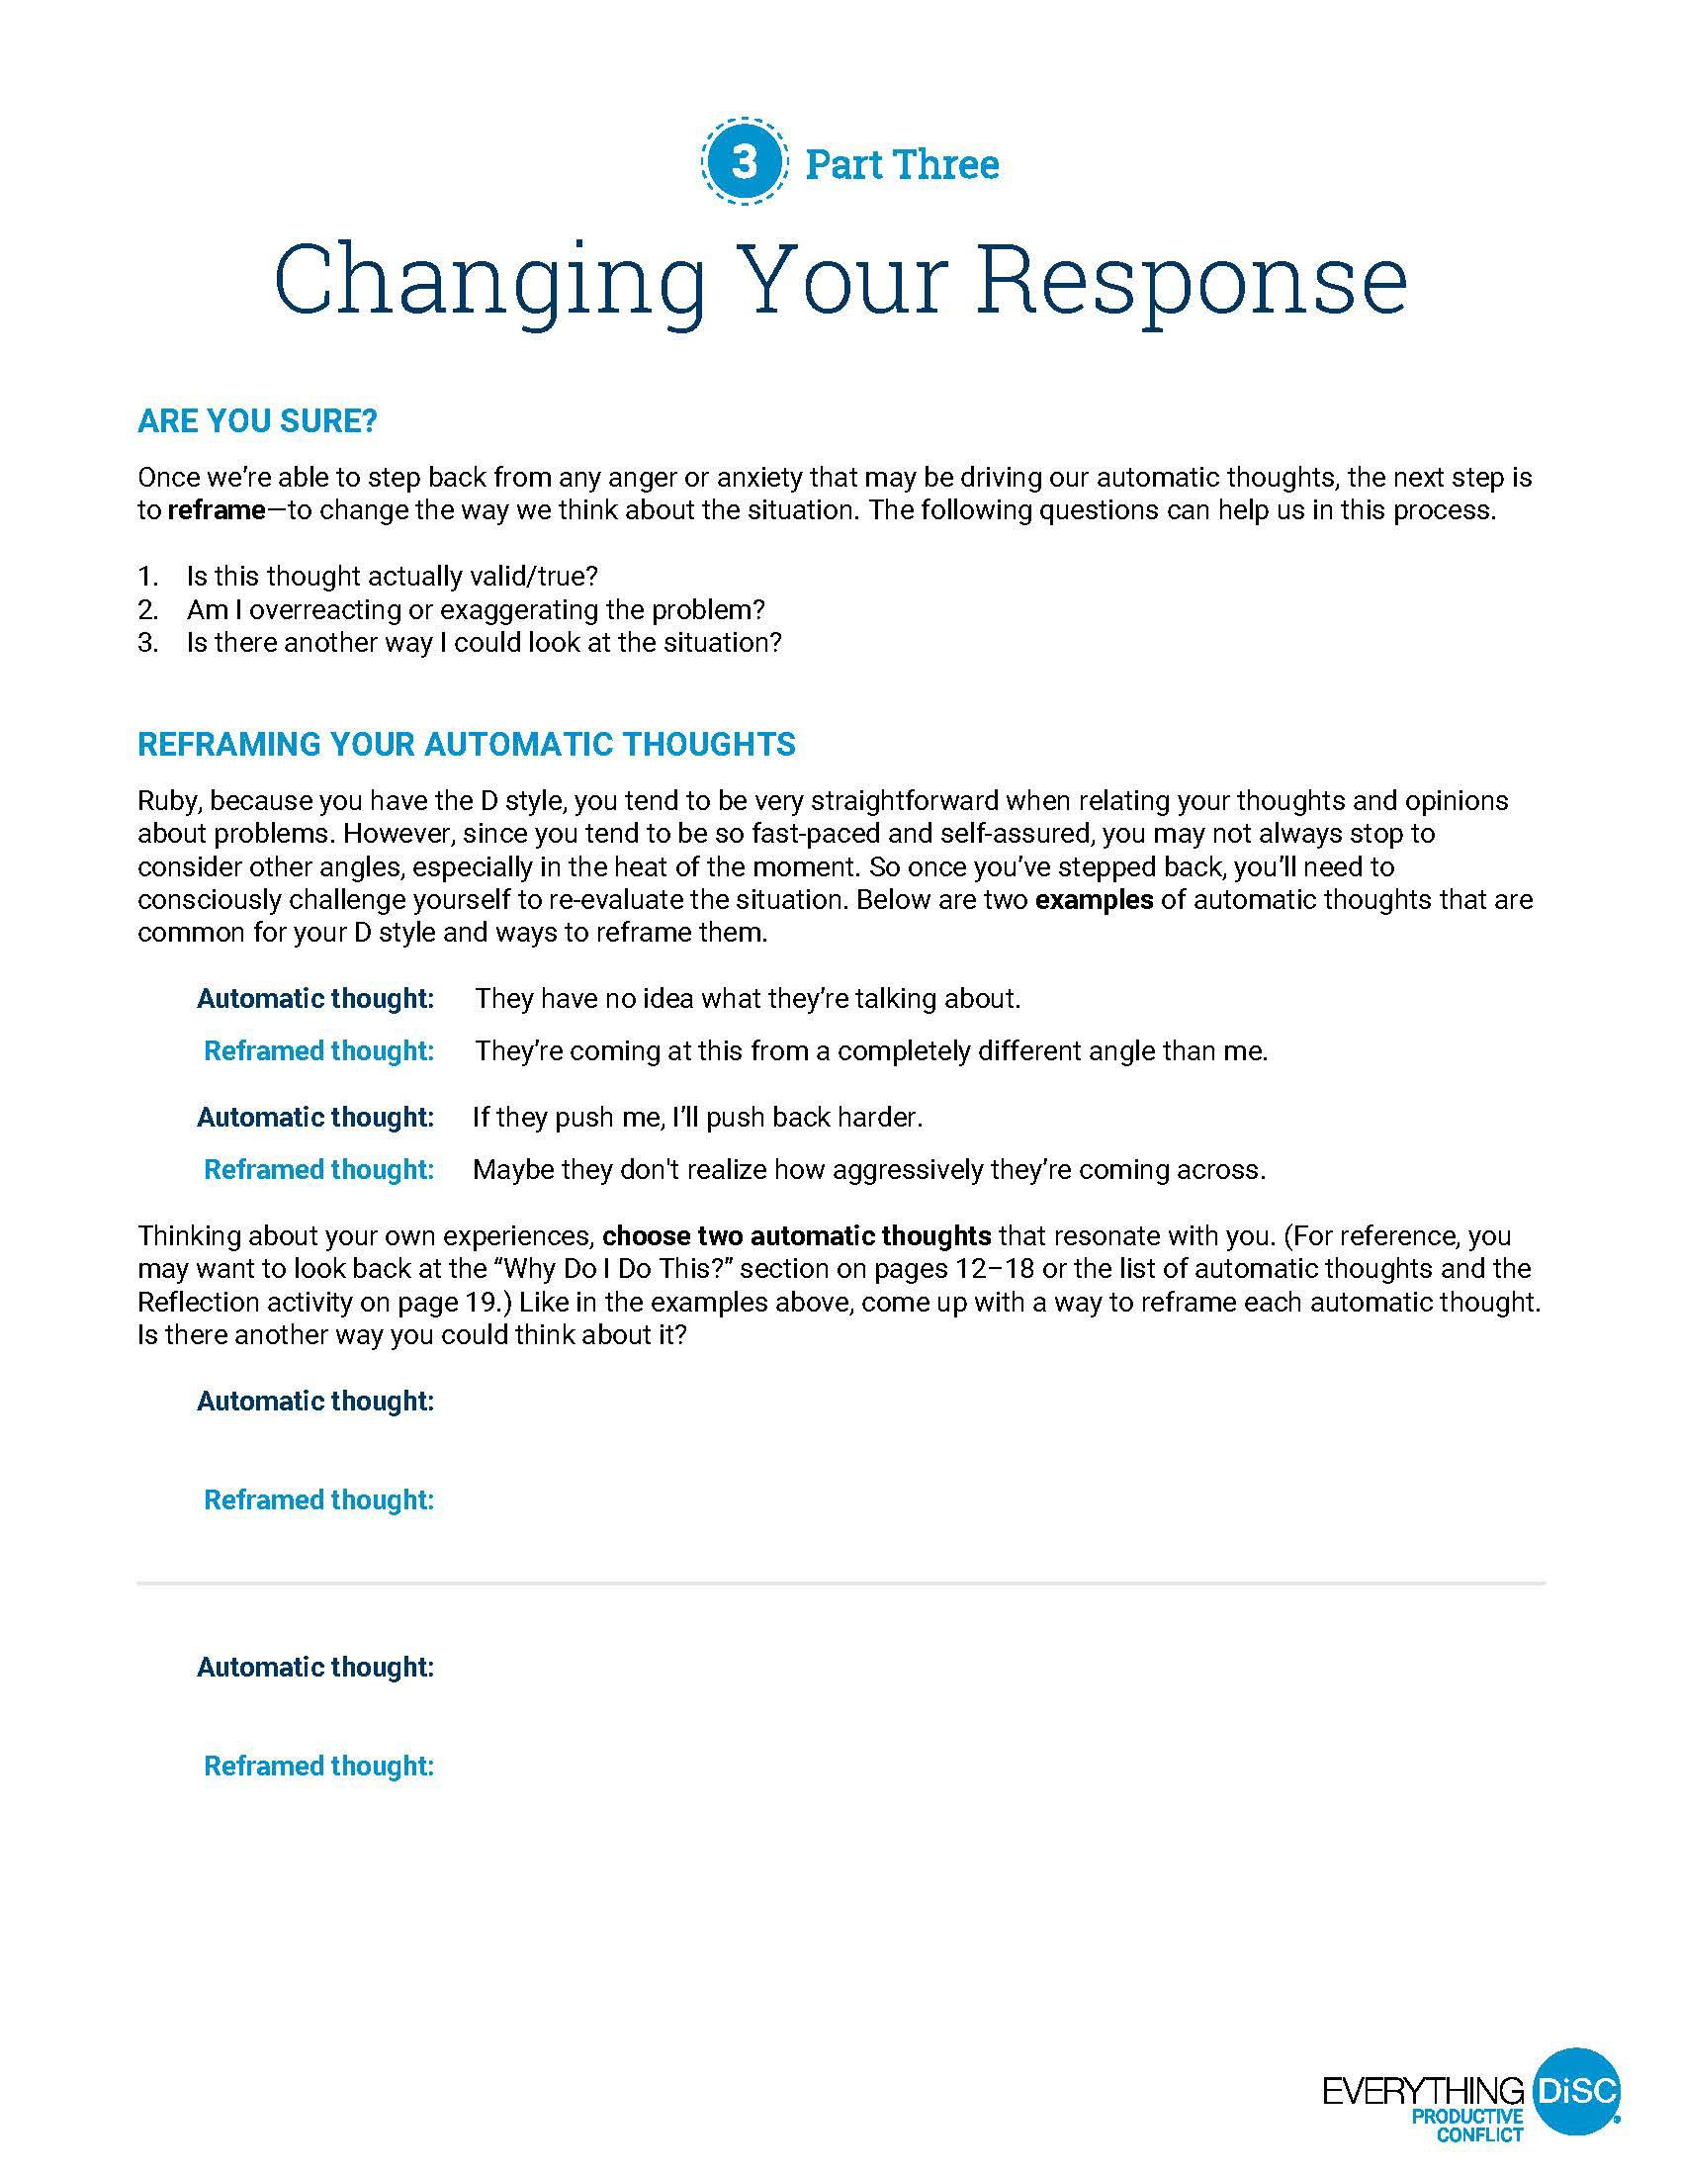
Reframing Automatic Thoughts
Page 21
Complete bottom of page 21
Refer back to pages 12–18, 19 as needed

