Slide 1
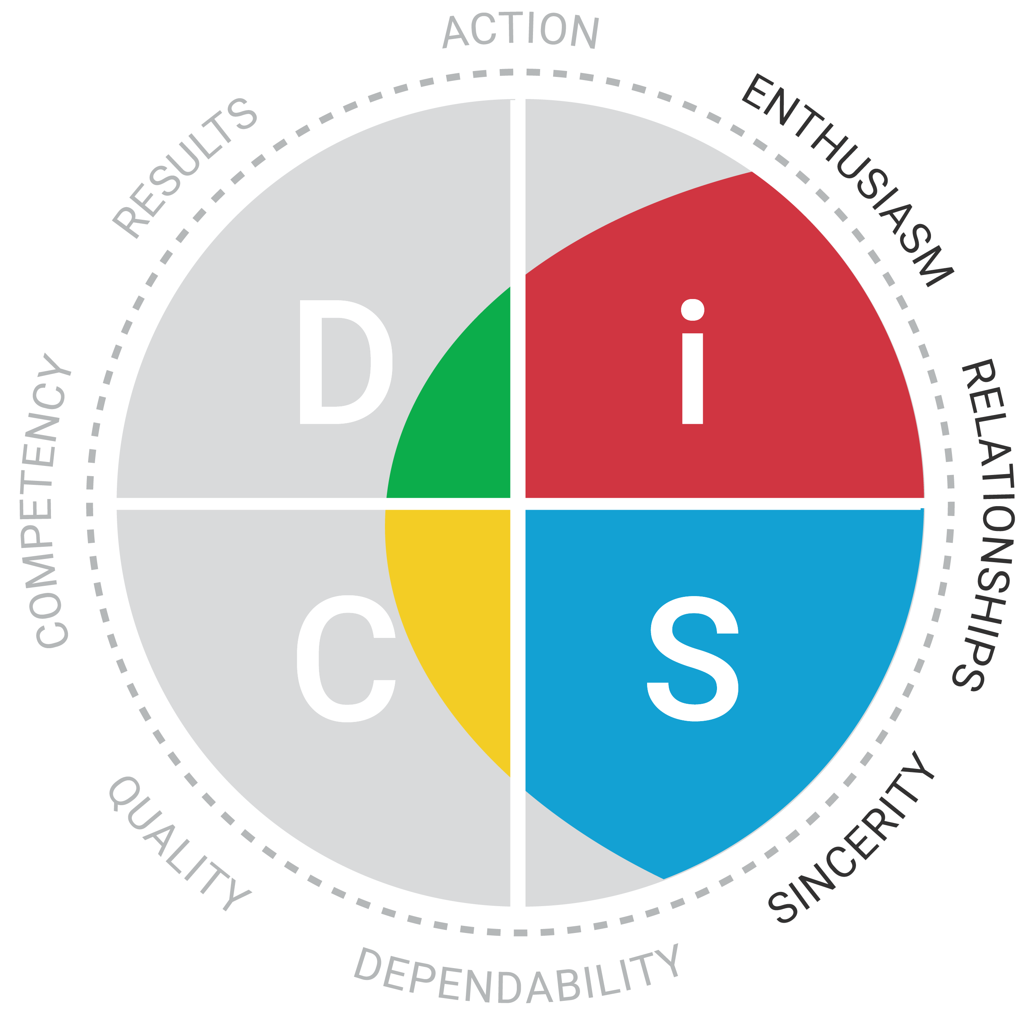
Your DiSC® Sales Priorities

Slide 2
Your DiSC® Style Priorities
Profile Page 5
Read and personalize
✓= like you
x = not like you
? = not sure



?

?
x


Slide 3
Your Sales Challenges
Profile Page 7
Read and personalize
✓= like you
x = not like you
? = not sure
= describes you best

?
?

x


Slide 4
Adapting to Your Customer
Profile Page 25
Read and personalize
✓= what you need to do to adapt
Write key statements and actions on Handout 6.1




